Slide 1
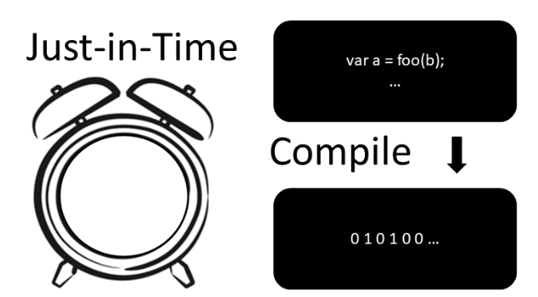
Workshop
Made by Jorge and Thijs

Slide 2
Table of contents
What is a compiler/interpreter?
How does a compiler/interpreter work?
What is JIT compiler?
What are the pros and cons of using jit compiler?
What are use cases for JIT compiler?
Future for JIT compiler?

Slide 3
What is a compiler/interpreter?
Source code – machine code
Lkajsdf
Lkasjdf
Lkjasdlkfj
Jlkajsdf
lkjasdf

Slide 4
How does a compiler/interpreter work?

Slide 5
What is JIT compiler?

Slide 6
What are the pros and cons of using jit compiler?

Slide 7
What are use cases for JIT compiler?

Slide 8
Future for JIT compiler?

Slide 9
Questions?

Slide 10
QUIZZ
Test

